Slide 1
Office 365 Development

Slide 2


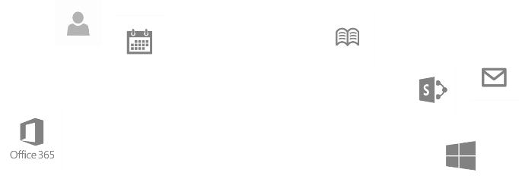
Recap
Deep Dive into Integrating Office 365 APIs with Web Applications
Module 1: Deep Dive into Azure AD with the Office 365 APIs
Module 2: Deep Dive into Office 365 APIs for Calendar, Mail, and Contacts
Module 3: Deep Dive into Office 365 APIs for OneDrive for Business
Module 4: Deep Dive into Office 365 APIs for SharePoint Site services
Module 5: Deep Dive into Office 365 APIs for Yammer services
Module 6: Deep Dive into Office 365 APIs for Office Graph
Module 7: Deep Dive into Office 365 APIs for OneNote services
dev.office.com/training

Slide 3
Course Agenda
Deep Dive into Integrating Office 365 APIs with mobile device development
Module 1: Universal Windows App Development with Office 365 APIs in Visual Studio 2013
Module 2: Cordova Development with Office 365​ APIs in Visual Studio 2013
Module 3: Xamarin Development with Office 365 APIs in Visual Studio 2013

Slide 4
Cordova Development with Office 365​ APIs in Visual Studio 2013
Speaker
Speaker

Slide 5

Agenda
Cordova Overview
Developing Cordova Apps
Cordova Apps and Office 365
Cordova Apps and AngularJS

Slide 6
Cordova Overview

Slide 7
What is a Hybrid App?
An app created with HTML5, CSS3 and JavaScript
Available through an app store
Different than a mobile web site
Hybrid app runs in browser of mobile device
Chromeless (no browser title bar, navigation buttons, etc.)
HTML, CSS and JavaScript downloaded and run locally from device
App launched in full screen mode
User isn’t aware that app is using browser

Slide 8
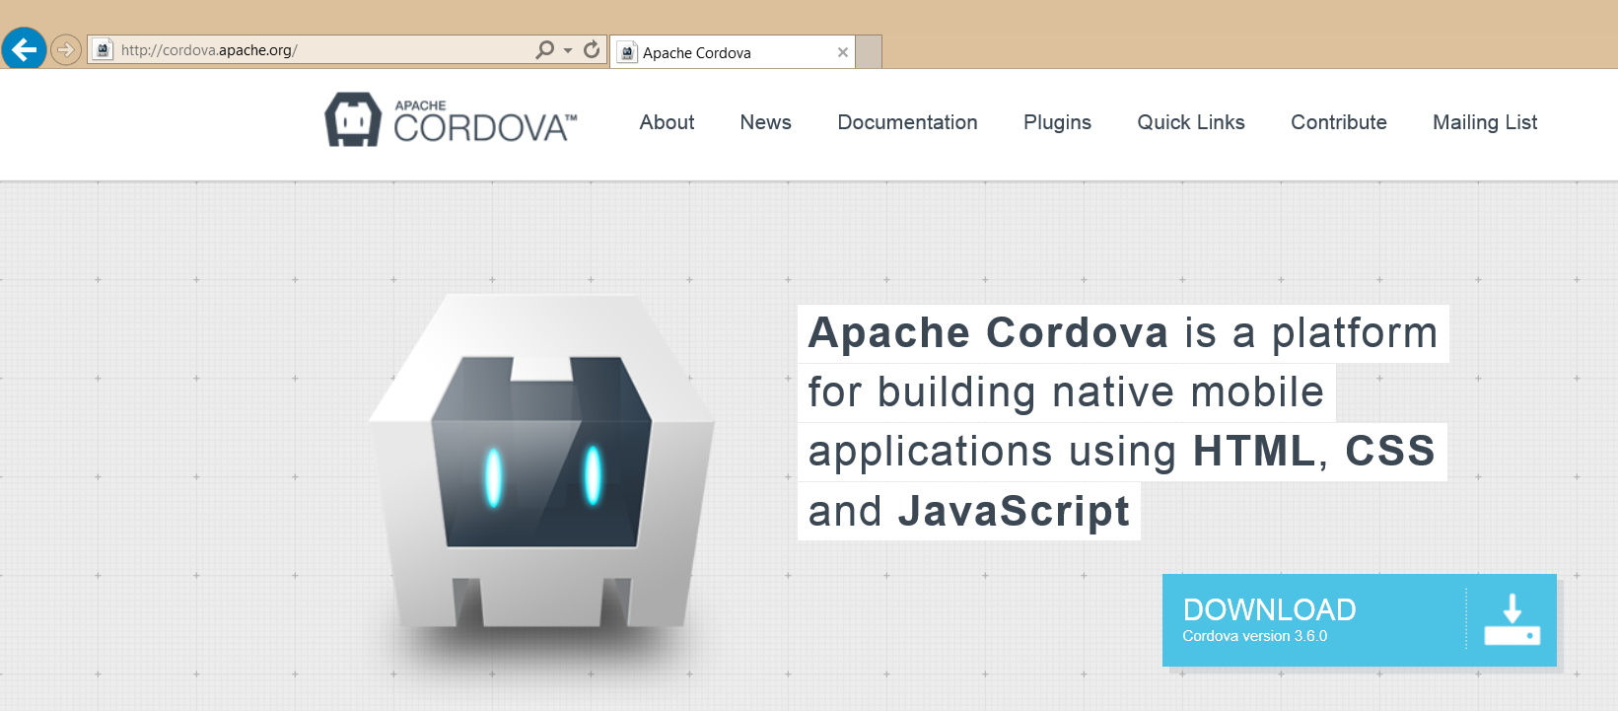
What is Cordova?
A platform for developing hybrid apps with HTML, CSS and JavaScript
An open source collection of JavaScript device APIs
Something that abstracts away device specific APIs
Toolsets built on top of Cordova
PhoneGap (Abode)
AppBuilder (Telerik)

Slide 9
Cordova in Visual Studio
MS Open Tech maintains Windows devices support
http://msopentech.com/apache-cordova
Provides developer environment support for CLI and Visual Studio
Command Line tools (CLI)
most popular amongst Web developers
can use PhoneGap Build service to build across platforms
Visual Studio integration (MDD)
Full integration with Visual Studio including emulators, cross-debugging, etc.
Builds for iOS, Android, Windows Phone and Windows Store

Slide 10
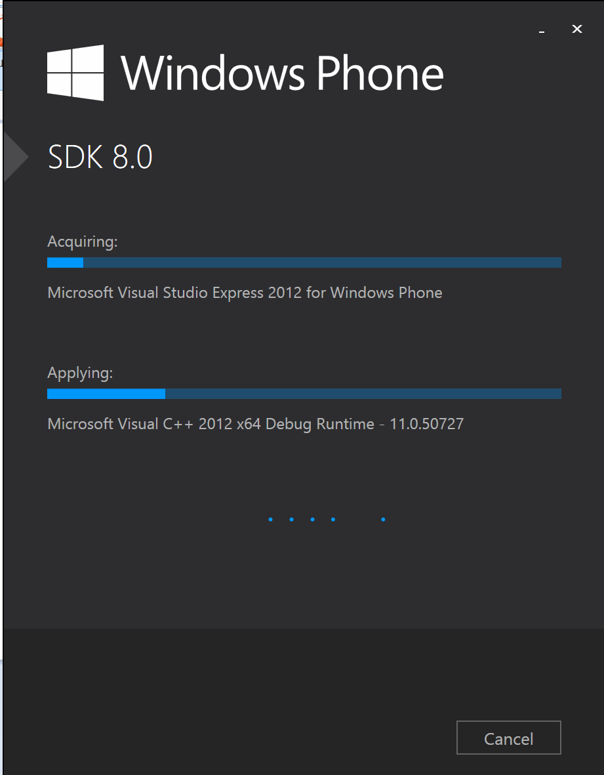
Setting Up Your Developer Environment
Installation Documentation
http://msdn.microsoft.com/en-us/library/dn757054.aspx
Setup Overview
Windows 8.1 or Windows Server 2012 R2
Visual Studio 2013 with Update 3 with Windows Phone SDK
Multi-Device Hybrid Apps for Visual Studio CTP 2.0

Slide 11
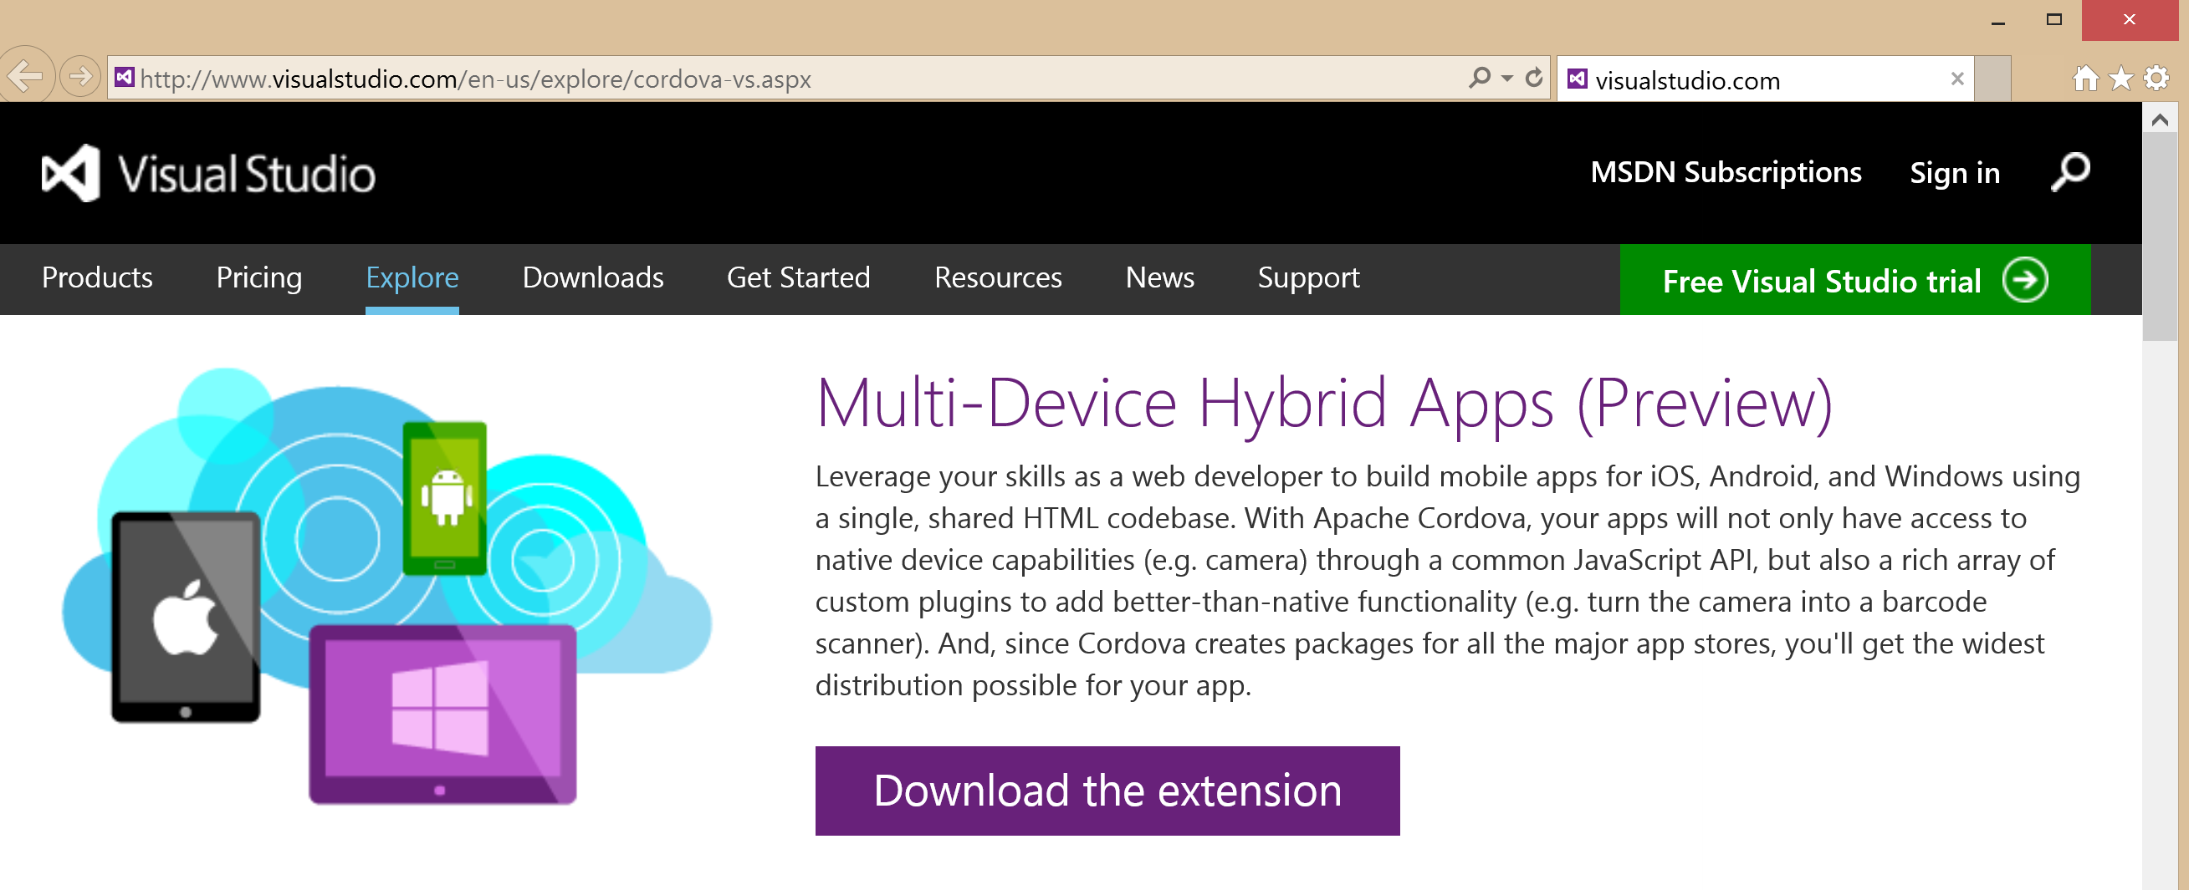
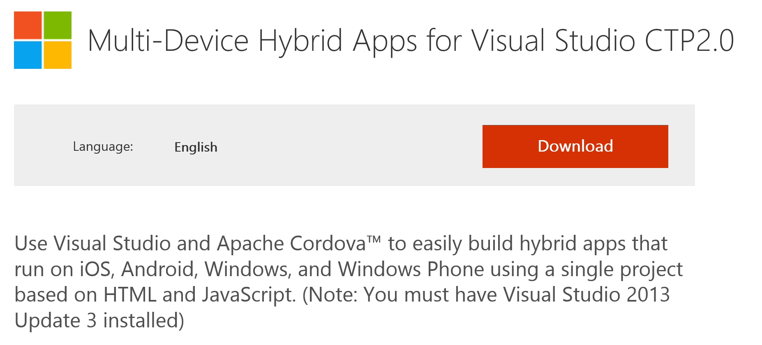
Multi-Device Hybrid Apps for Visual Studio

Slide 12
Developing Cordova Apps

Slide 13
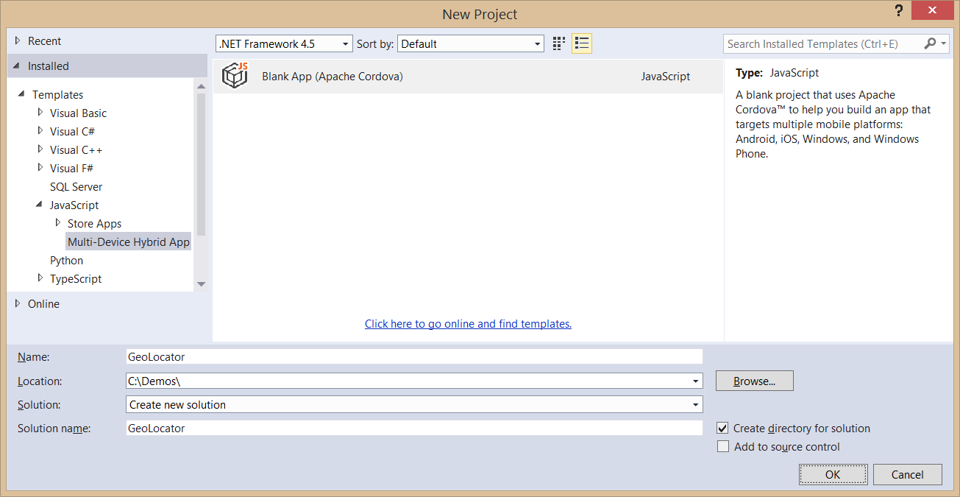
Creating a Cordova App
Use the Blank App (Apache Cordova) template
Templates > JavaScript > Multi-Device Hybrid Apps

Slide 14
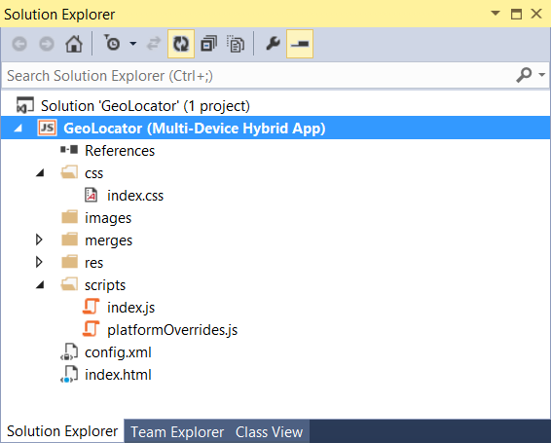
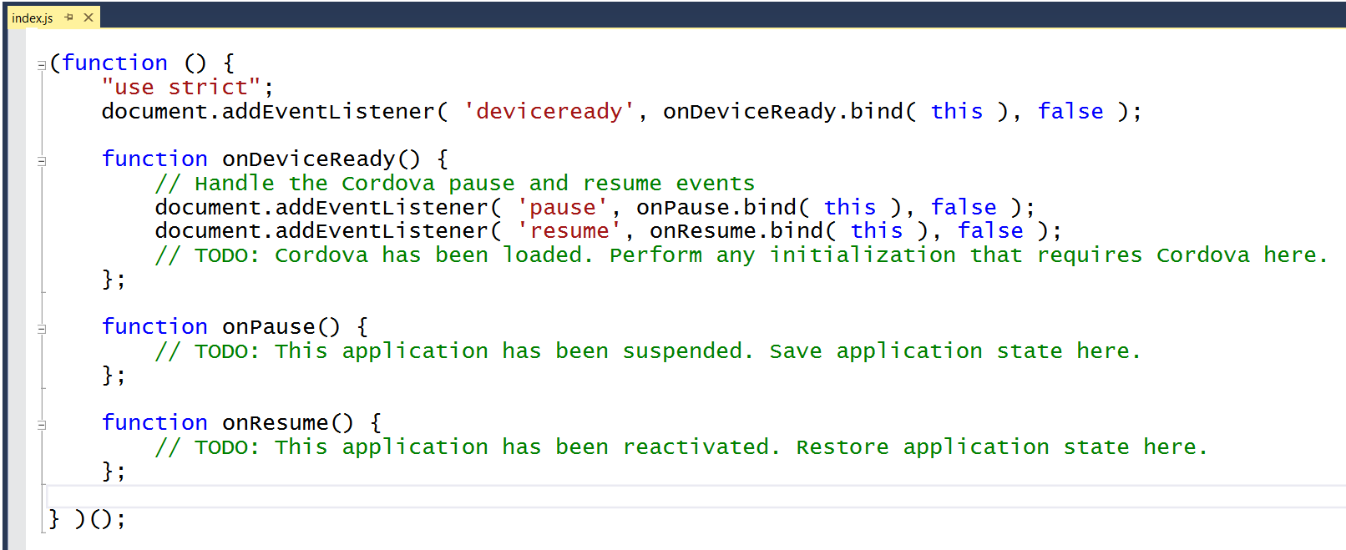
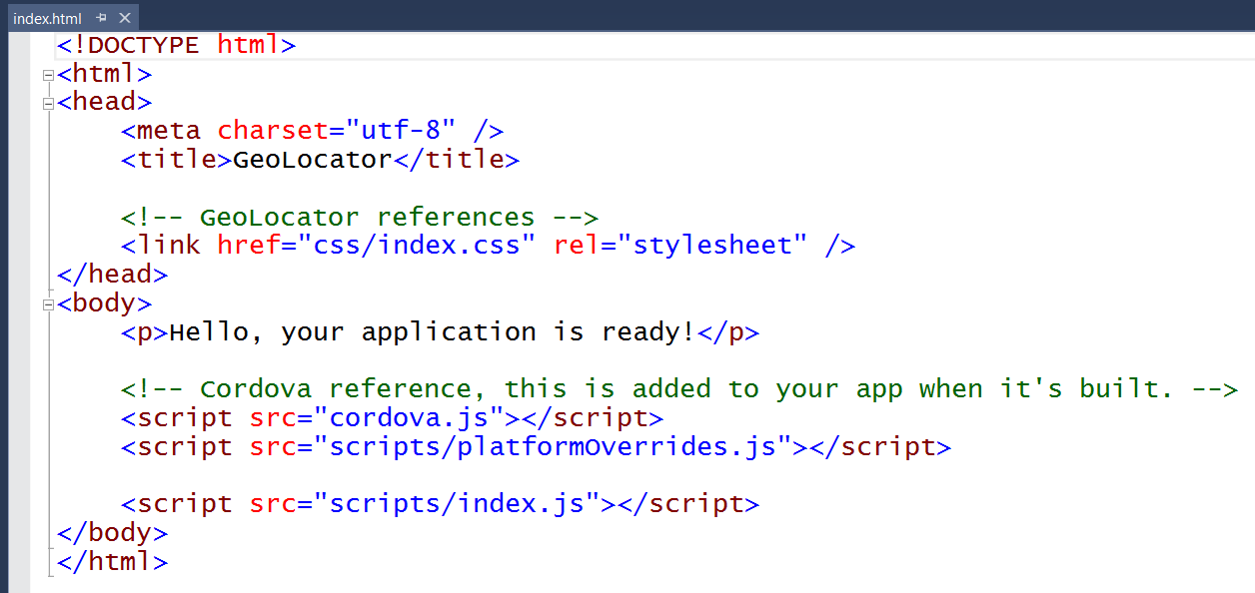
Cordova App Starting Point

Slide 15
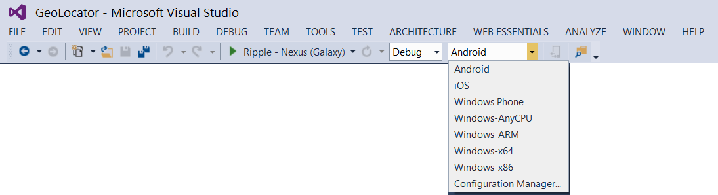
Selecting a Debug Target
Android
Windows Phone
Other Windows Devices

Slide 16
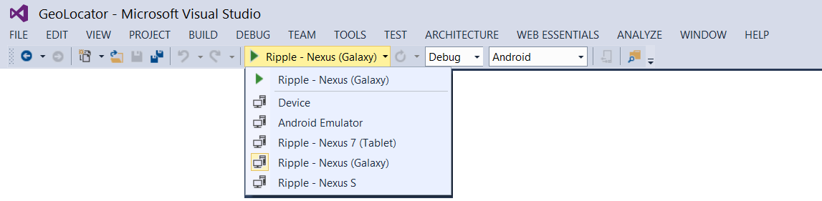
Android Emulators and Debugging
Apache Ripple emulator
Android emulator
Genymotion emulator
Android device

Slide 17
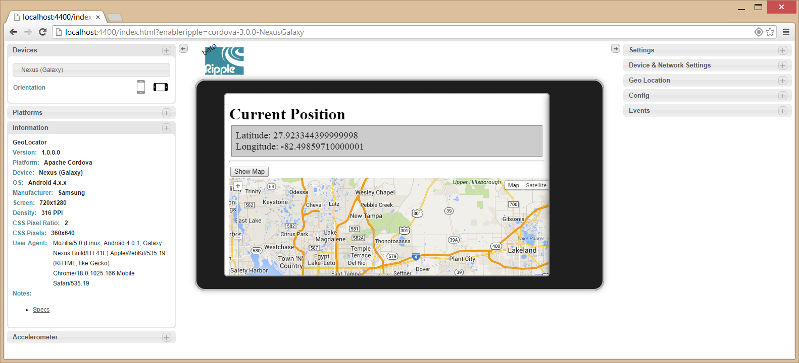
Debugging with Ripple
Included with Android SDK
Runs inside Chrome browser

Slide 18
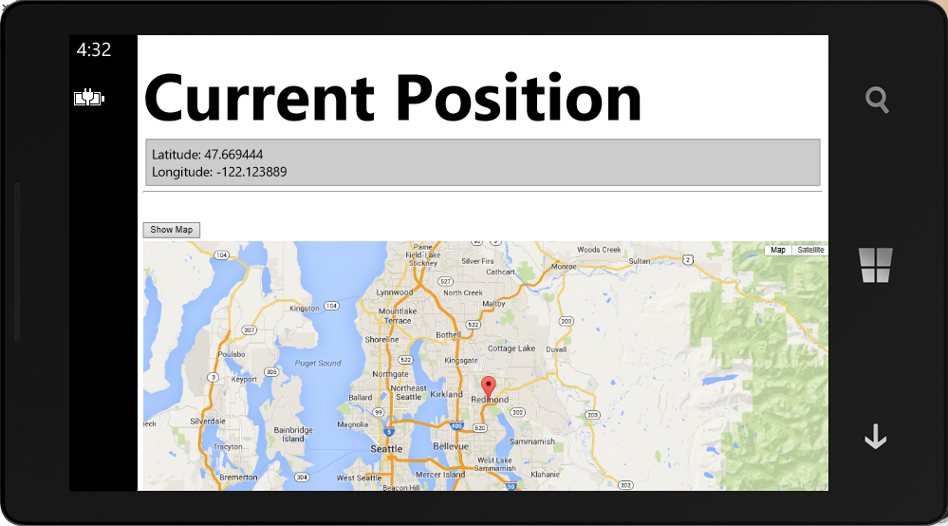
Debugging with Windows Phone
You can use a Windows Phone emulator
You can use an attached Windows Phone device

Slide 19
Creating and Running a Cordova App Project

Slide 20
Cordova Apps and Office 365

Slide 21
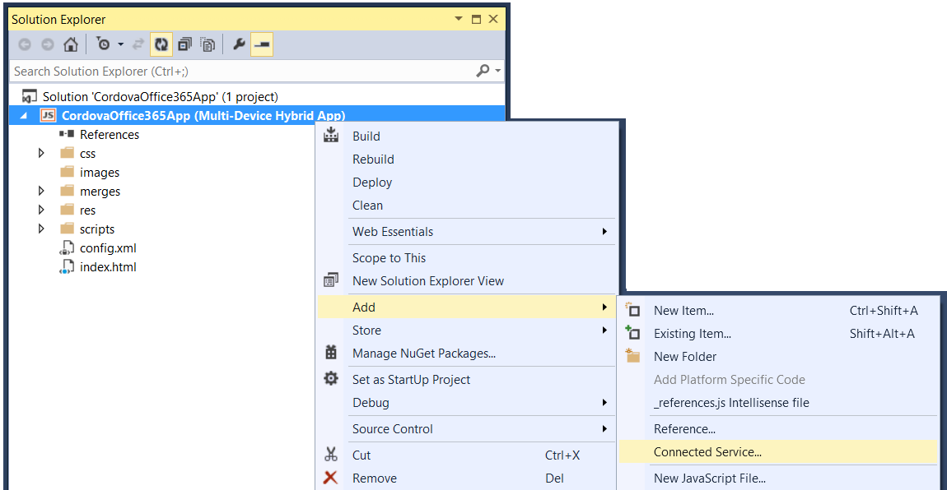
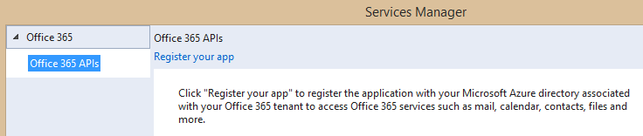
Adding Connected Services
1
Project > Add > Connected Service…
2
Register your app

Slide 22
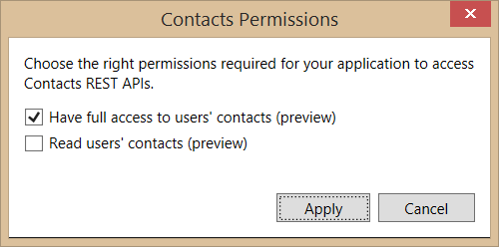
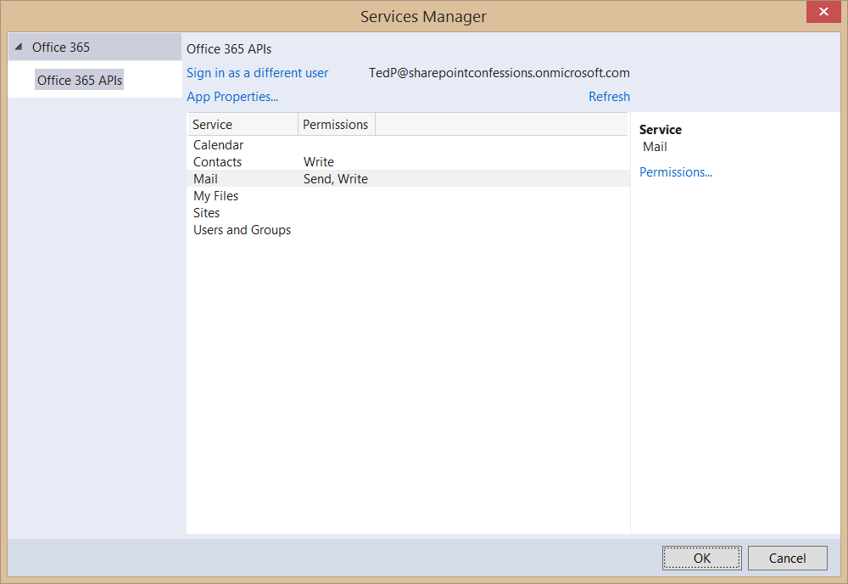
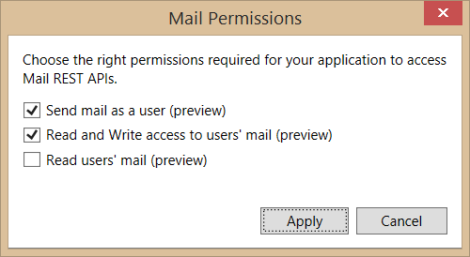
Connected Services Permissions
3
Select required app permissions

Slide 23
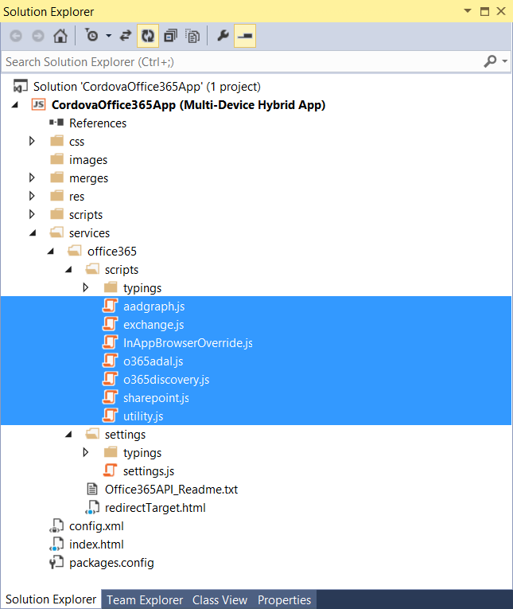
Office 365 API Libraries
Added with Connected Service
Provides JS libraries for AAD authentication
Provides JS libraries for accessing Exchange
Provides JS libraries for accessing SharePoint

Slide 24
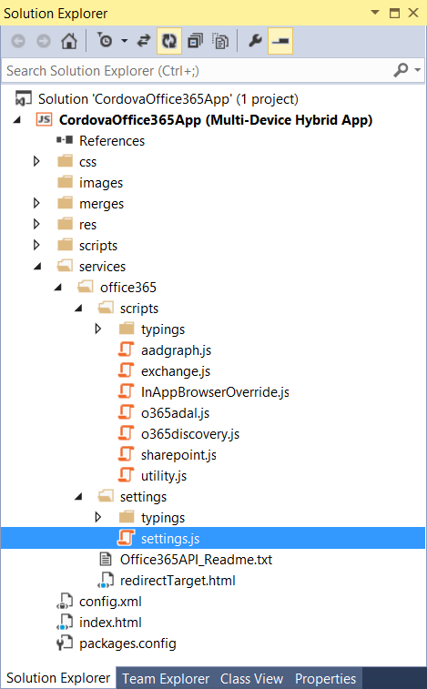
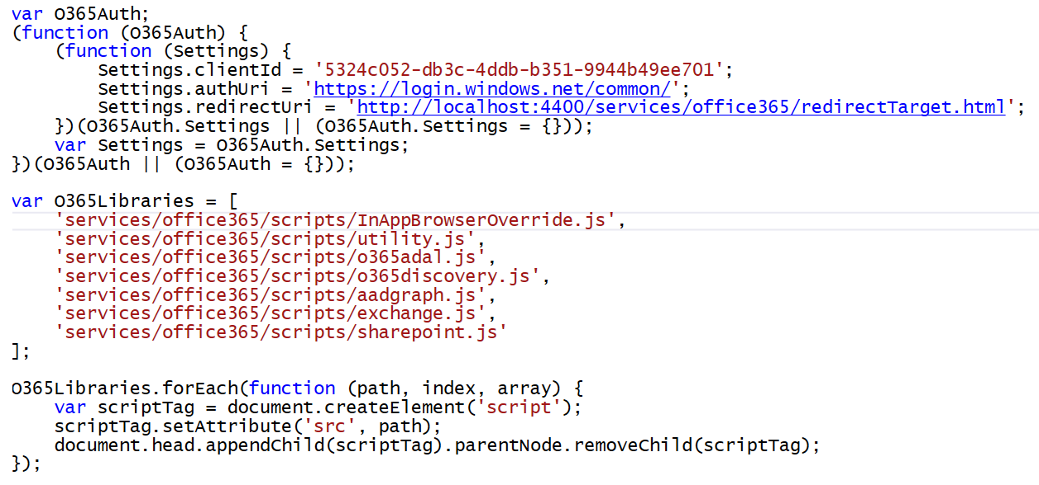
Linking to settings.js
Link index.html to settings.js
The JavaScript inside automatically links to other script files

Slide 25
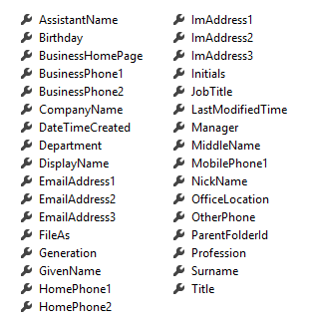
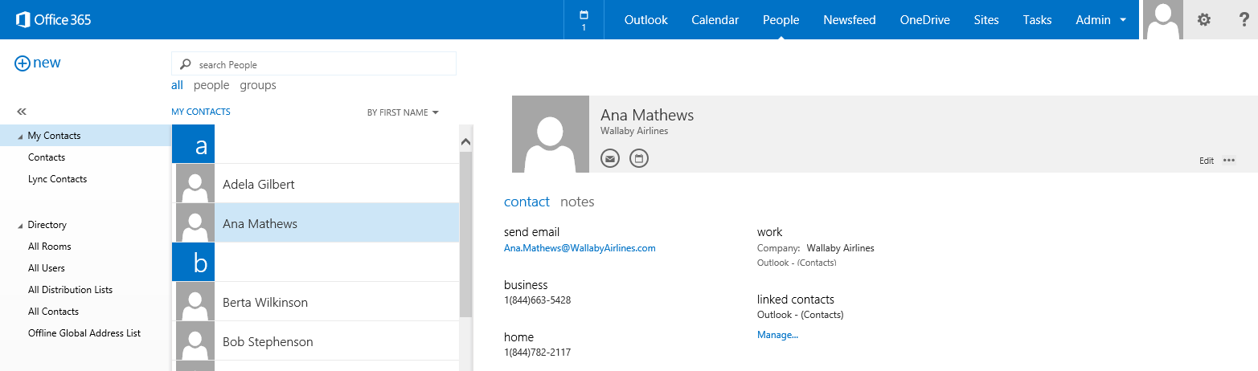
Contacts
Common API operations
Reading contacts
Searching for contacts
Creating contacts
Deleting contacts
Editing events
Contact

Slide 26
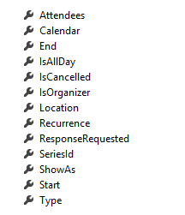
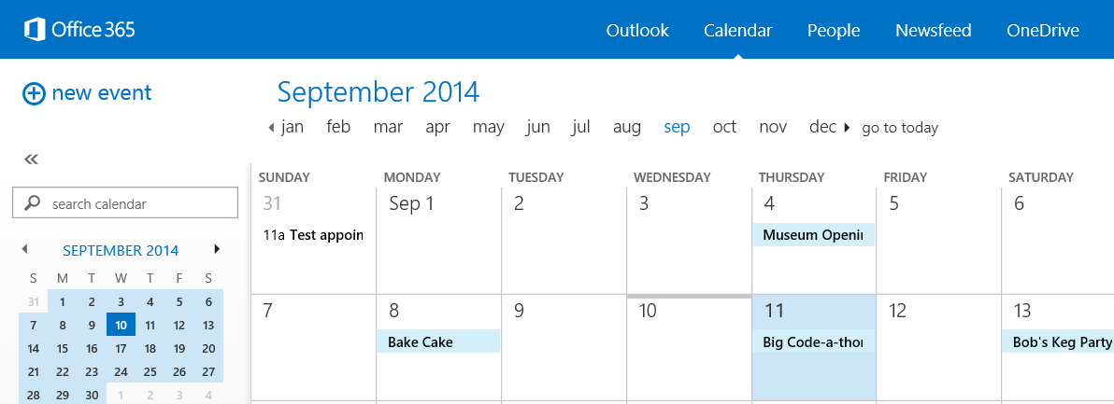
Calendar Events
Common API operations
Reading events for specific date range
Creating events
Deleting events
Editing events
Event

Slide 27
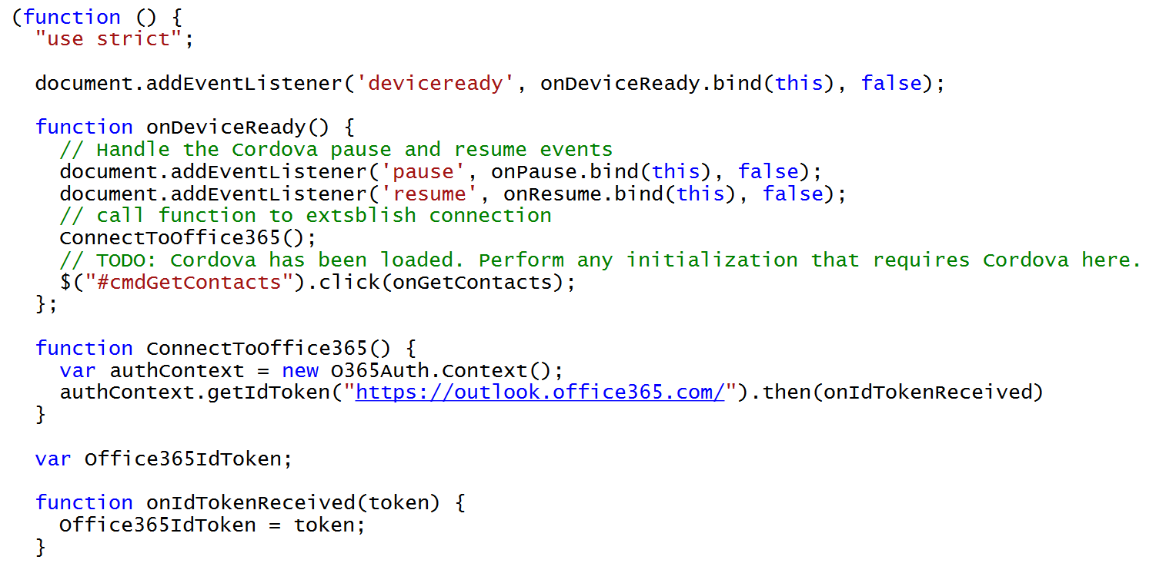
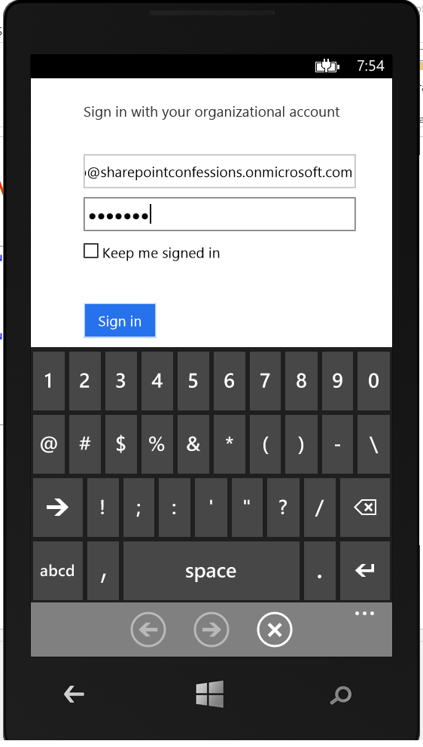
Connecting with the Office 365 APIs

Slide 28
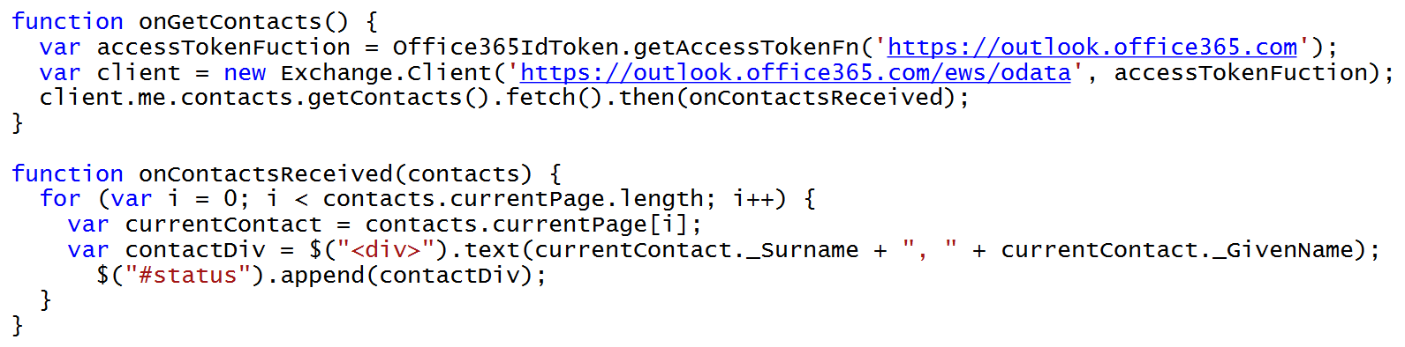
Accessing Office 365 Contacts

Slide 29
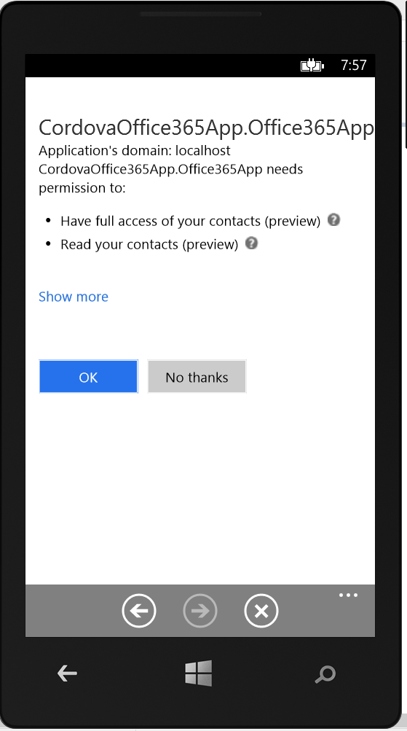
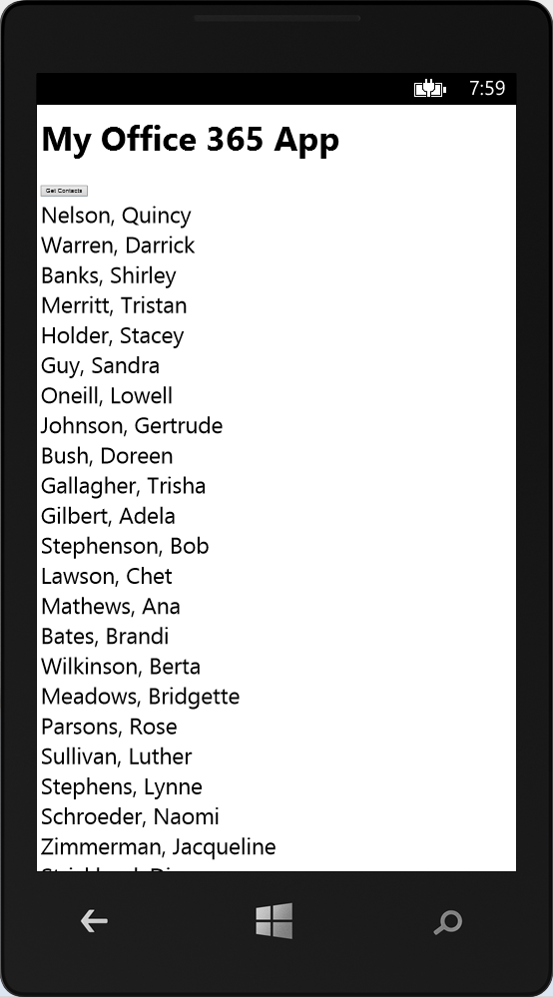
Testing the App using Windows Phone

Slide 30
demo
Examining the CordovaOffice365API App Project

Slide 31
Cordova Apps and AngularJS

Slide 32
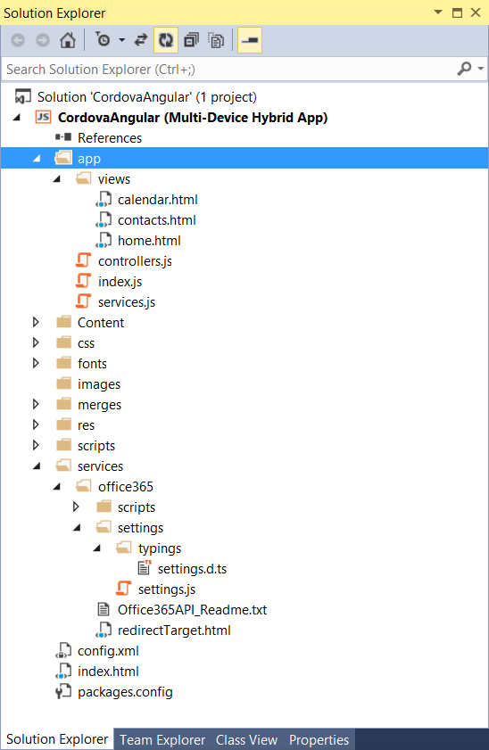
Structure of an Cordova/Angular App

Slide 33
demo
Examining the CordovaAngular project

Slide 34
Summary
Cordova Overview
Developing Cordova Apps
Cordova Apps and Office 365
Cordova Apps and AngularJS

Slide 35
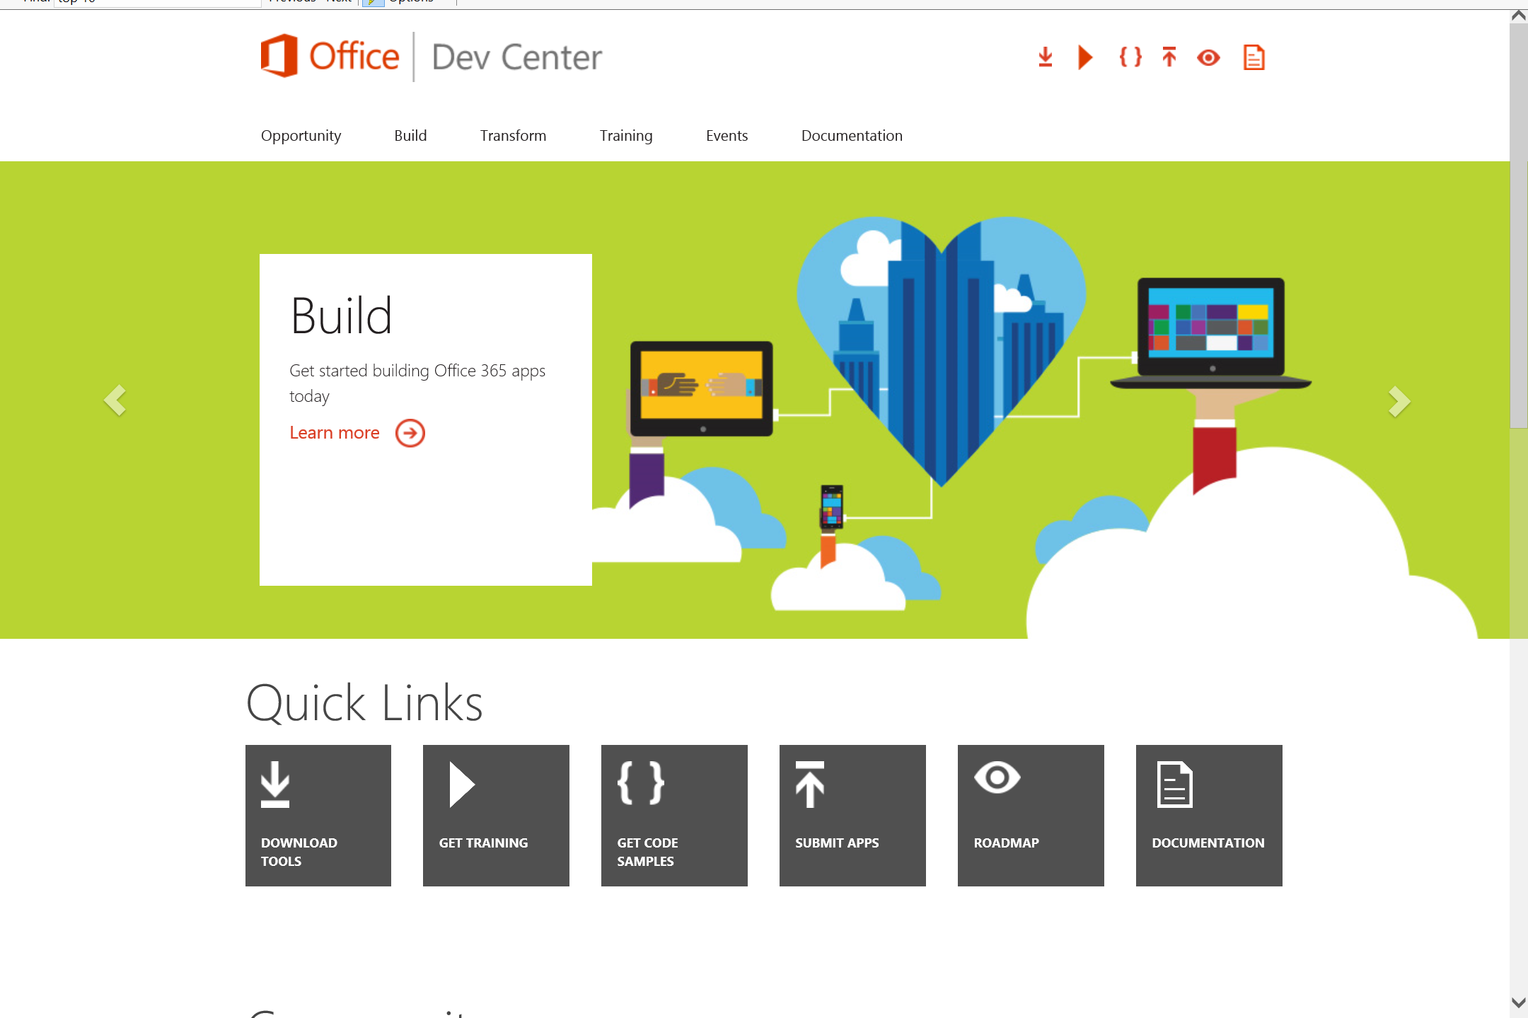
Dev.
Office
.com
One stop shop for Office Developer Platform

Slide 36
Calls to action
Explore our developer center
http://dev.office.com
Jumpstart into our training http://dev.office.com/training
Play with our code samples http://dev.office.com/code-samples
Get answers
http://aka.ms/AskSharePoint
http://aka.ms/AskOffice
Give feedback Drive our roadmap http://aka.ms/OfficeDevFeedback

Slide 37


Transform your code Providing App Model Patterns for common Full Trust Code scenarios
60+ Visual Studio projects Common scenarios
Branding
Site provisioning
Remote event receivers
Large file support
Taxonomy driven navigation
And much more…
Contribute
Open source coming soon!
Developer
Patterns & Practices
aka.ms/OfficeDevPnP

Slide 38
Microsoft Virtual Academy courses
2014
2015
Deep Dive into integrating Office 365 APIs with your mobile device development
Deep dive into the building blocks and services of the SharePoint platform
Deep Dive into integrating Office 365 APIs with your standalone web application development
Introduction to Office 365 Development
Deep Dive into the Office 365 App Model
Deep Dive into Office 365 Development on non-Microsoft Stack
Shipping your Office 365 App to the Office Store
Aug
Sept
Oct
Nov
Dec
Jan
Feb

Slide 39

© 2014 Microsoft Corporation. All rights reserved. Microsoft, Windows, and other product names are or may be registered trademarks and/or trademarks in the U.S. and/or other countries.
The information herein is for informational purposes only and represents the current view of Microsoft Corporation as of the date of this presentation. Because Microsoft must respond to changing market conditions, it should not be interpreted to be a commitment on the part of Microsoft, and Microsoft cannot guarantee the accuracy of any information provided after the date of this presentation. MICROSOFT MAKES NO WARRANTIES, EXPRESS, IMPLIED OR STATUTORY, AS TO THE INFORMATION IN THIS PRESENTATION.

